Slide 1
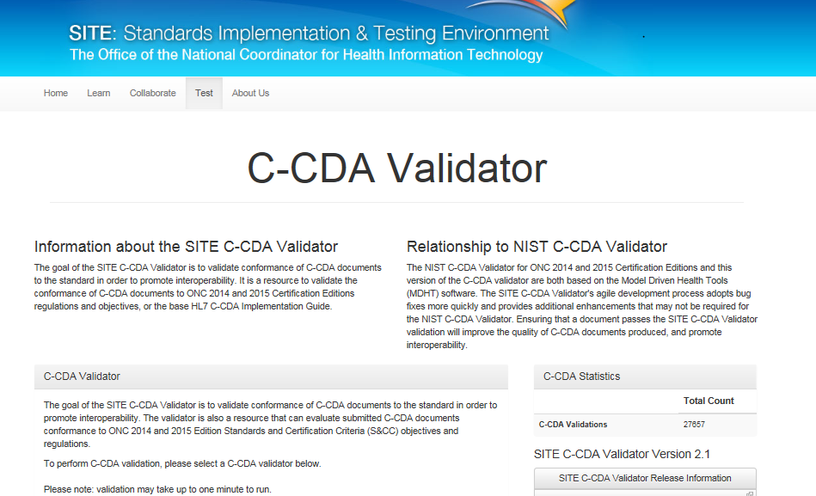
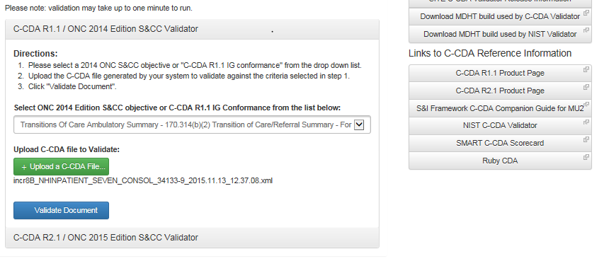
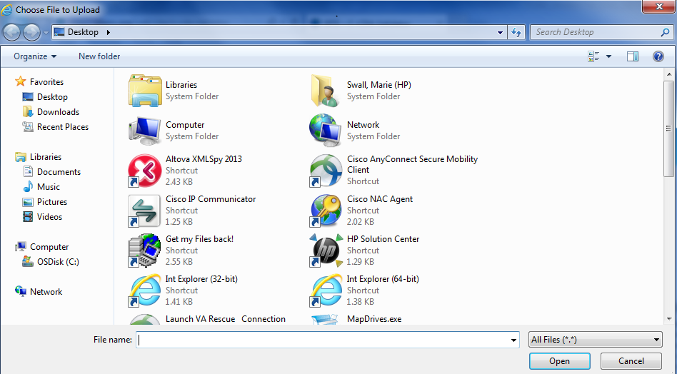
Clinical Summary
Transitions of Care/Referral Summary – For Ambulatory Care
Transitions of Care – Data Portability– For Ambulatory Care
Transitions of Care Receive – For Ambulatory Care
Transitions of Care/Referral Summary – For Inpatient Care
Transitions of Care – Data Portability– For Inpatient Care
Transitions of Care Receive – For Inpatient Care
VDT Ambulatory Summary – Ambulatory Summary
VDT Ambulatory Summary – Inpatient Summary
C-CDA R1.1 IG Conformance

Slide 2

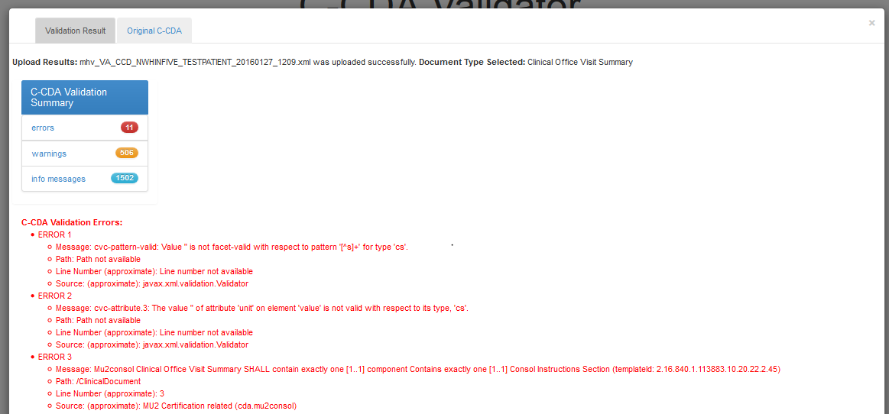
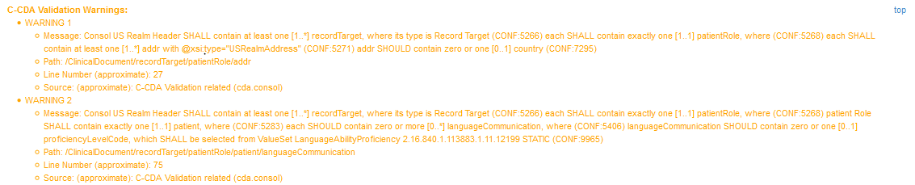
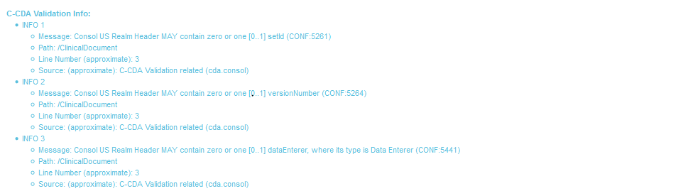

Slide 3
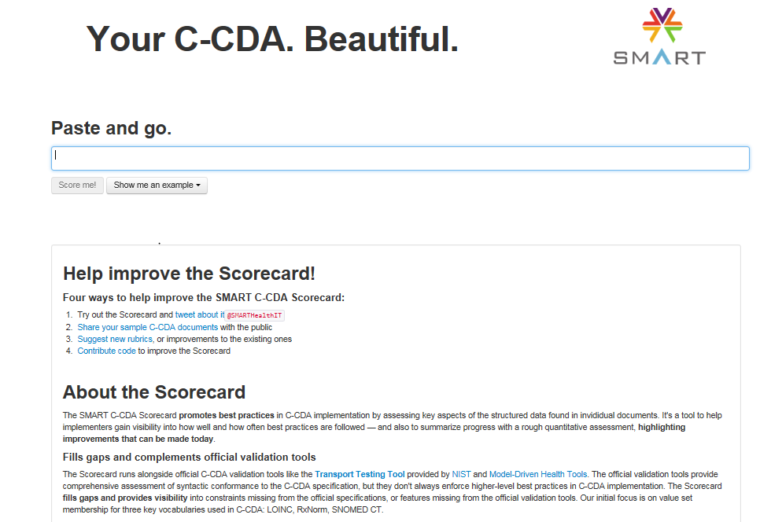

Slide 4

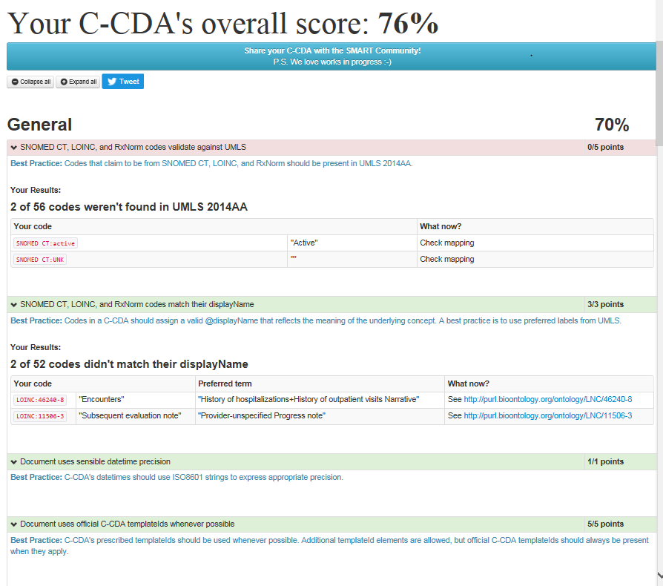
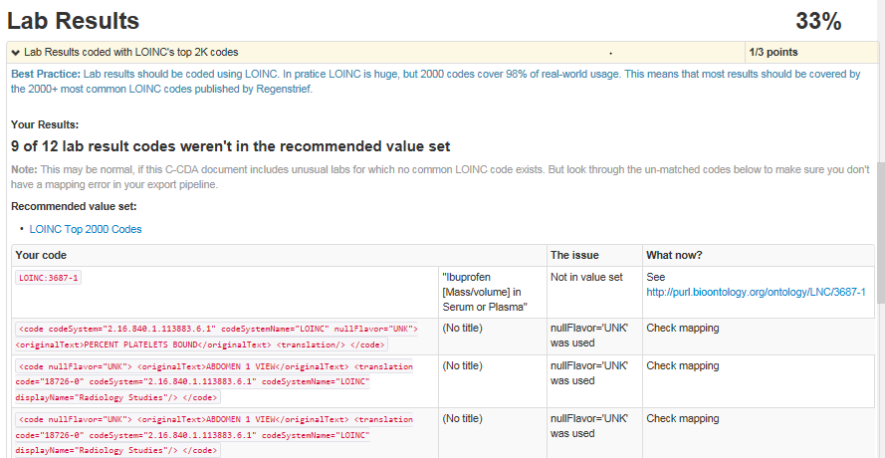
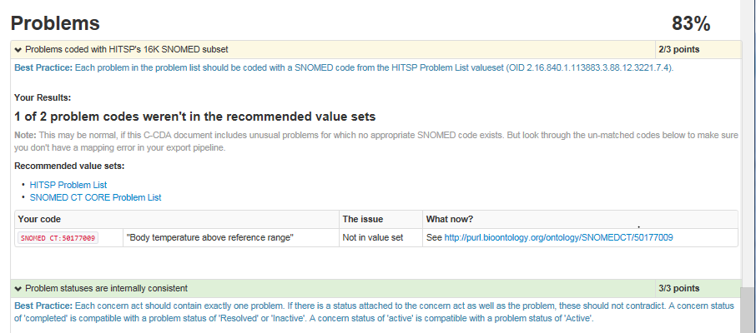

Slide 5
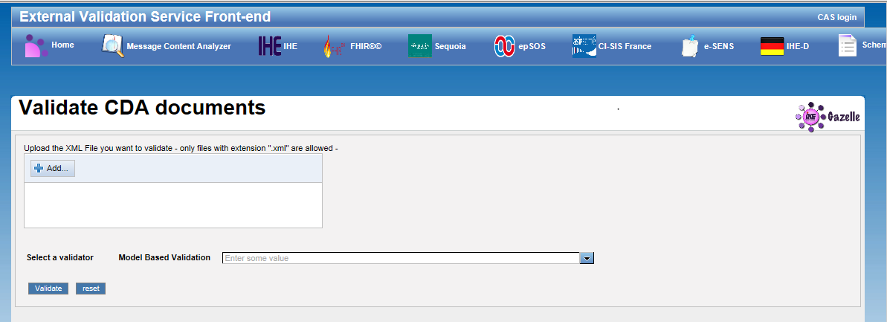
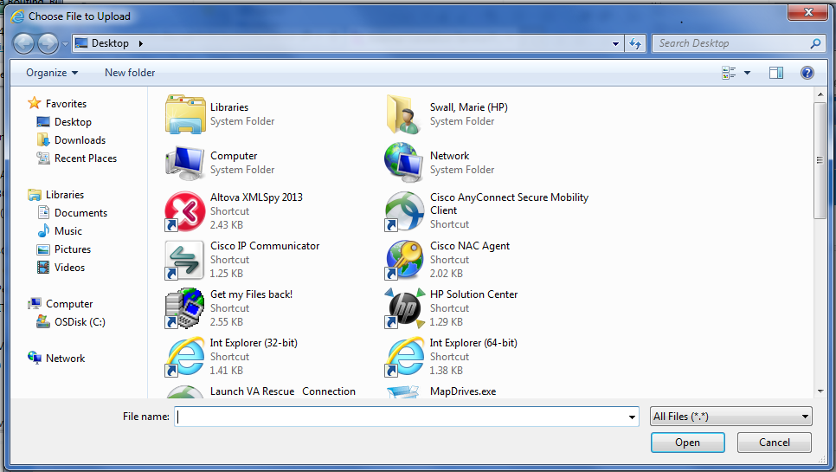
HL7 – C-CDA R1.1
HL7 – CDA Release 2

Slide 6
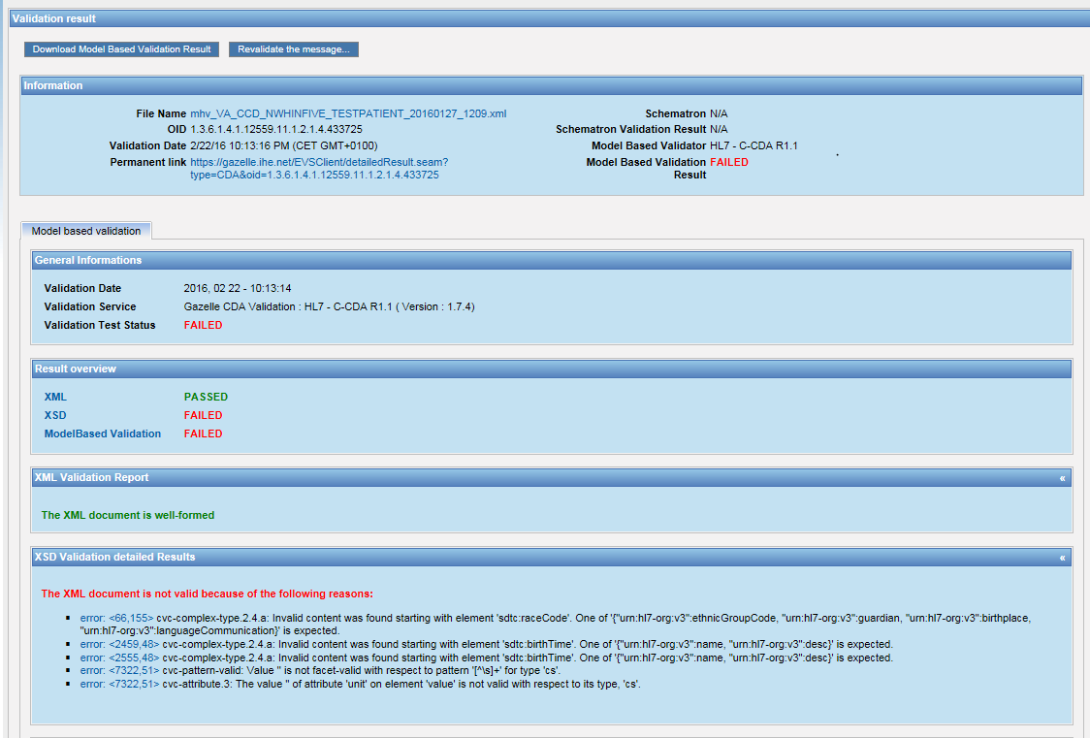
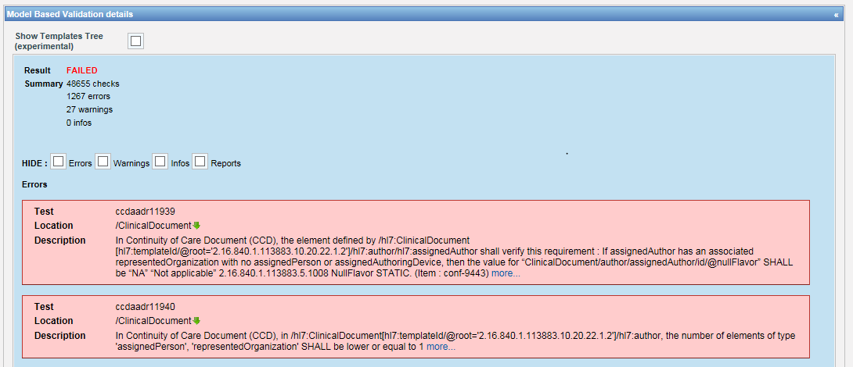

Slide 7
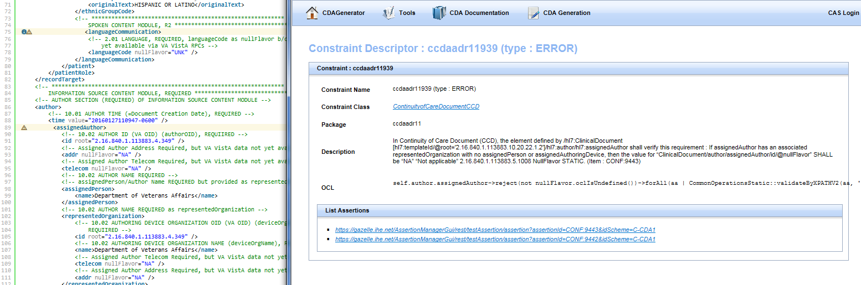
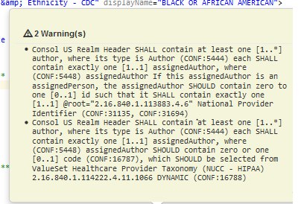
Errors Found in Gazelle , Not in Site C-CDA Validator

